Slide 1
After School Early Childhood Programs (AECP)
Supper Service Training

Slide 2
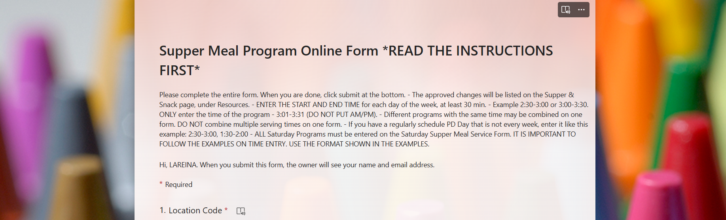
Supper Online Form
When beginning a new supper service for After School Early Childhood programs Food Service Managers must enter the service time and location in the Supper Program Online Form located on the FSD website.
Café La Website for Internal Use > Food Service Resources > Supper Program

Slide 3
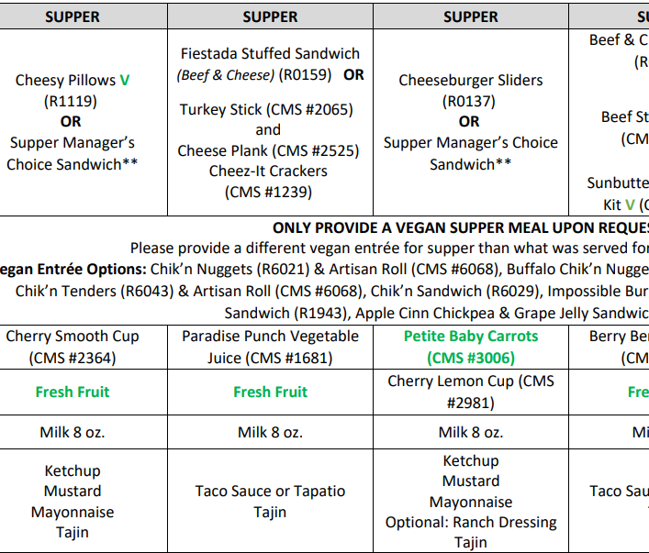
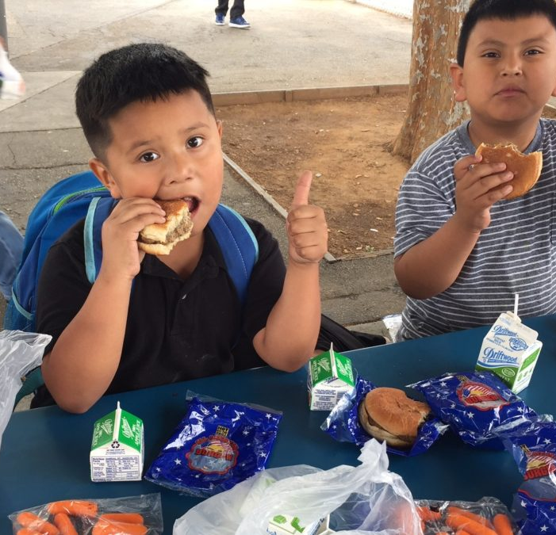
Supper Menu
Managers will follow the 4 and under supper menu with choking hazard items omitted for all AECP students.
AECP staff can find the supper menu on the Yum Yummy app.

Slide 4
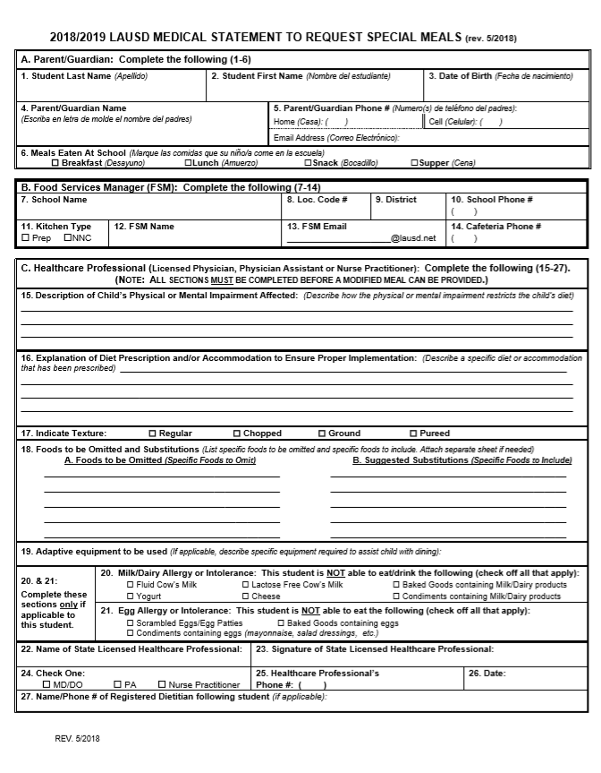
Special Dietary Needs for AECP
Managers consult with AECP staff if special diets are needed.
Managers will supply AECP staff with the “Medical Statement to Request Special Diets” form to give to students/parents.
The “Medical Statement to Request Special Diets” form must be signed by the students treating physician.

Slide 5
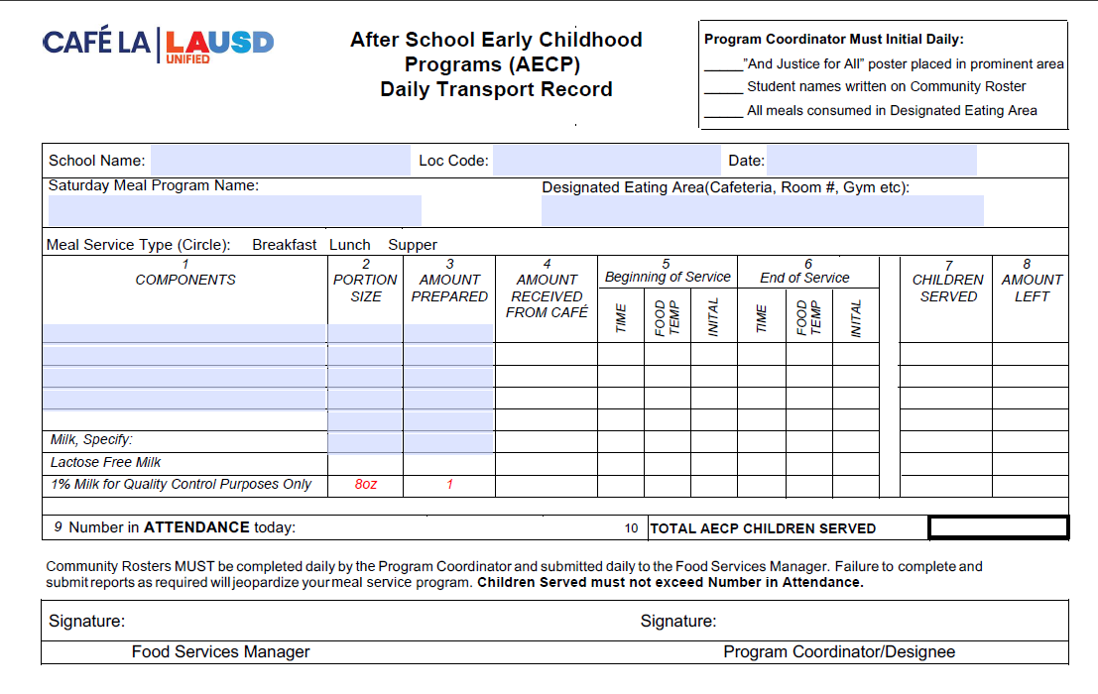
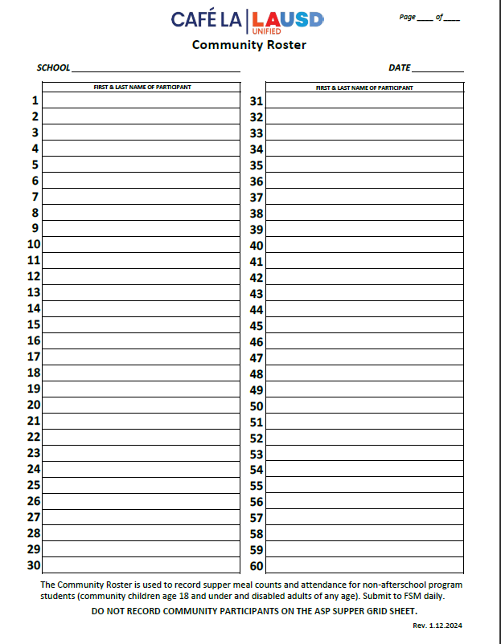
AECP Daily Meal Forms
Daily Meal Transport Record
Daily Community Roster
All leftovers, completed transport logs and community rosters must be returned to the cafeteria at the end of service.

Slide 6
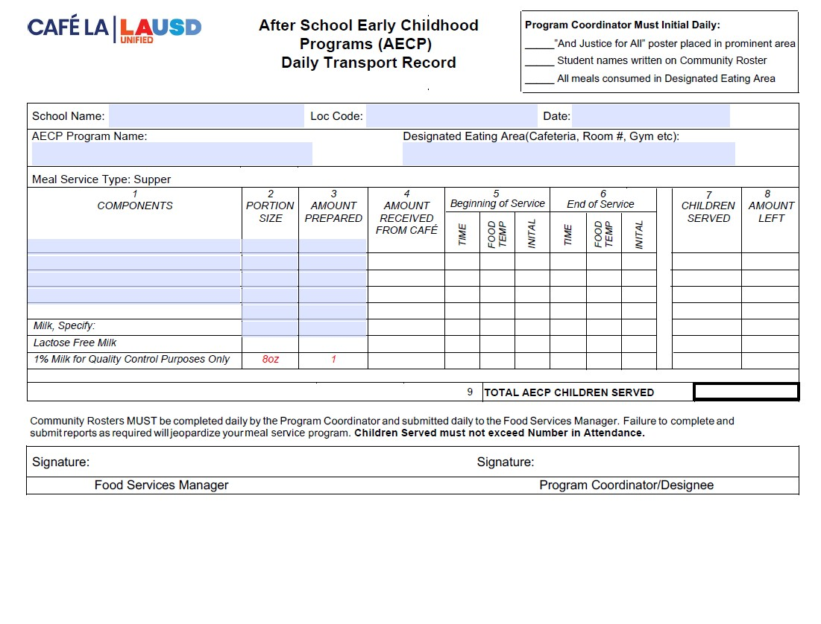
Transport Record
are used whenever food is being served outside of FSD hands.
Once received AECP staff will then fill amount received, temp each item at the beginning and end of service. Document children served and the amount leftover.
FSM will pre-fill the header with school name, location code, date, etc.
Once service has completed AECP staff will record the total children served reimbursable meals
FSM will pre-fill components, portion size, and amount prepared
Before returning Daily Transport Record, AECP staff will sign. Verifying all information is true and correct.
FSM will sign once record is returned. Signifying all fields have been properly filled.

Slide 7
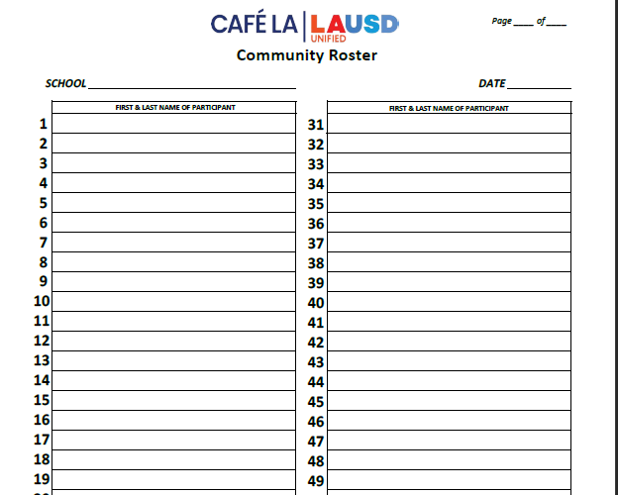
Community Roster
This form records the attendance and reimbursable meals received by AECP students.
AECP will fill in the top portion of the community roster for School, Program and Date.
AECP staff will write AECP at the top of the community roster.
Ensure first & last names are written legibly.
Young children may be assisted with writing their names.
It is acceptable to pre-populate the roster with the names of the students. Check marks following the names indicate a reimbursable meal has been taken.
AECP Staff ensures a reimbursable meal is selected before names are recorded.
Submit to FS Manager daily.
AECP
1 2
ABC Elementary
2/28/25
Nicole Waterford
Hannah Bankole

Slide 8
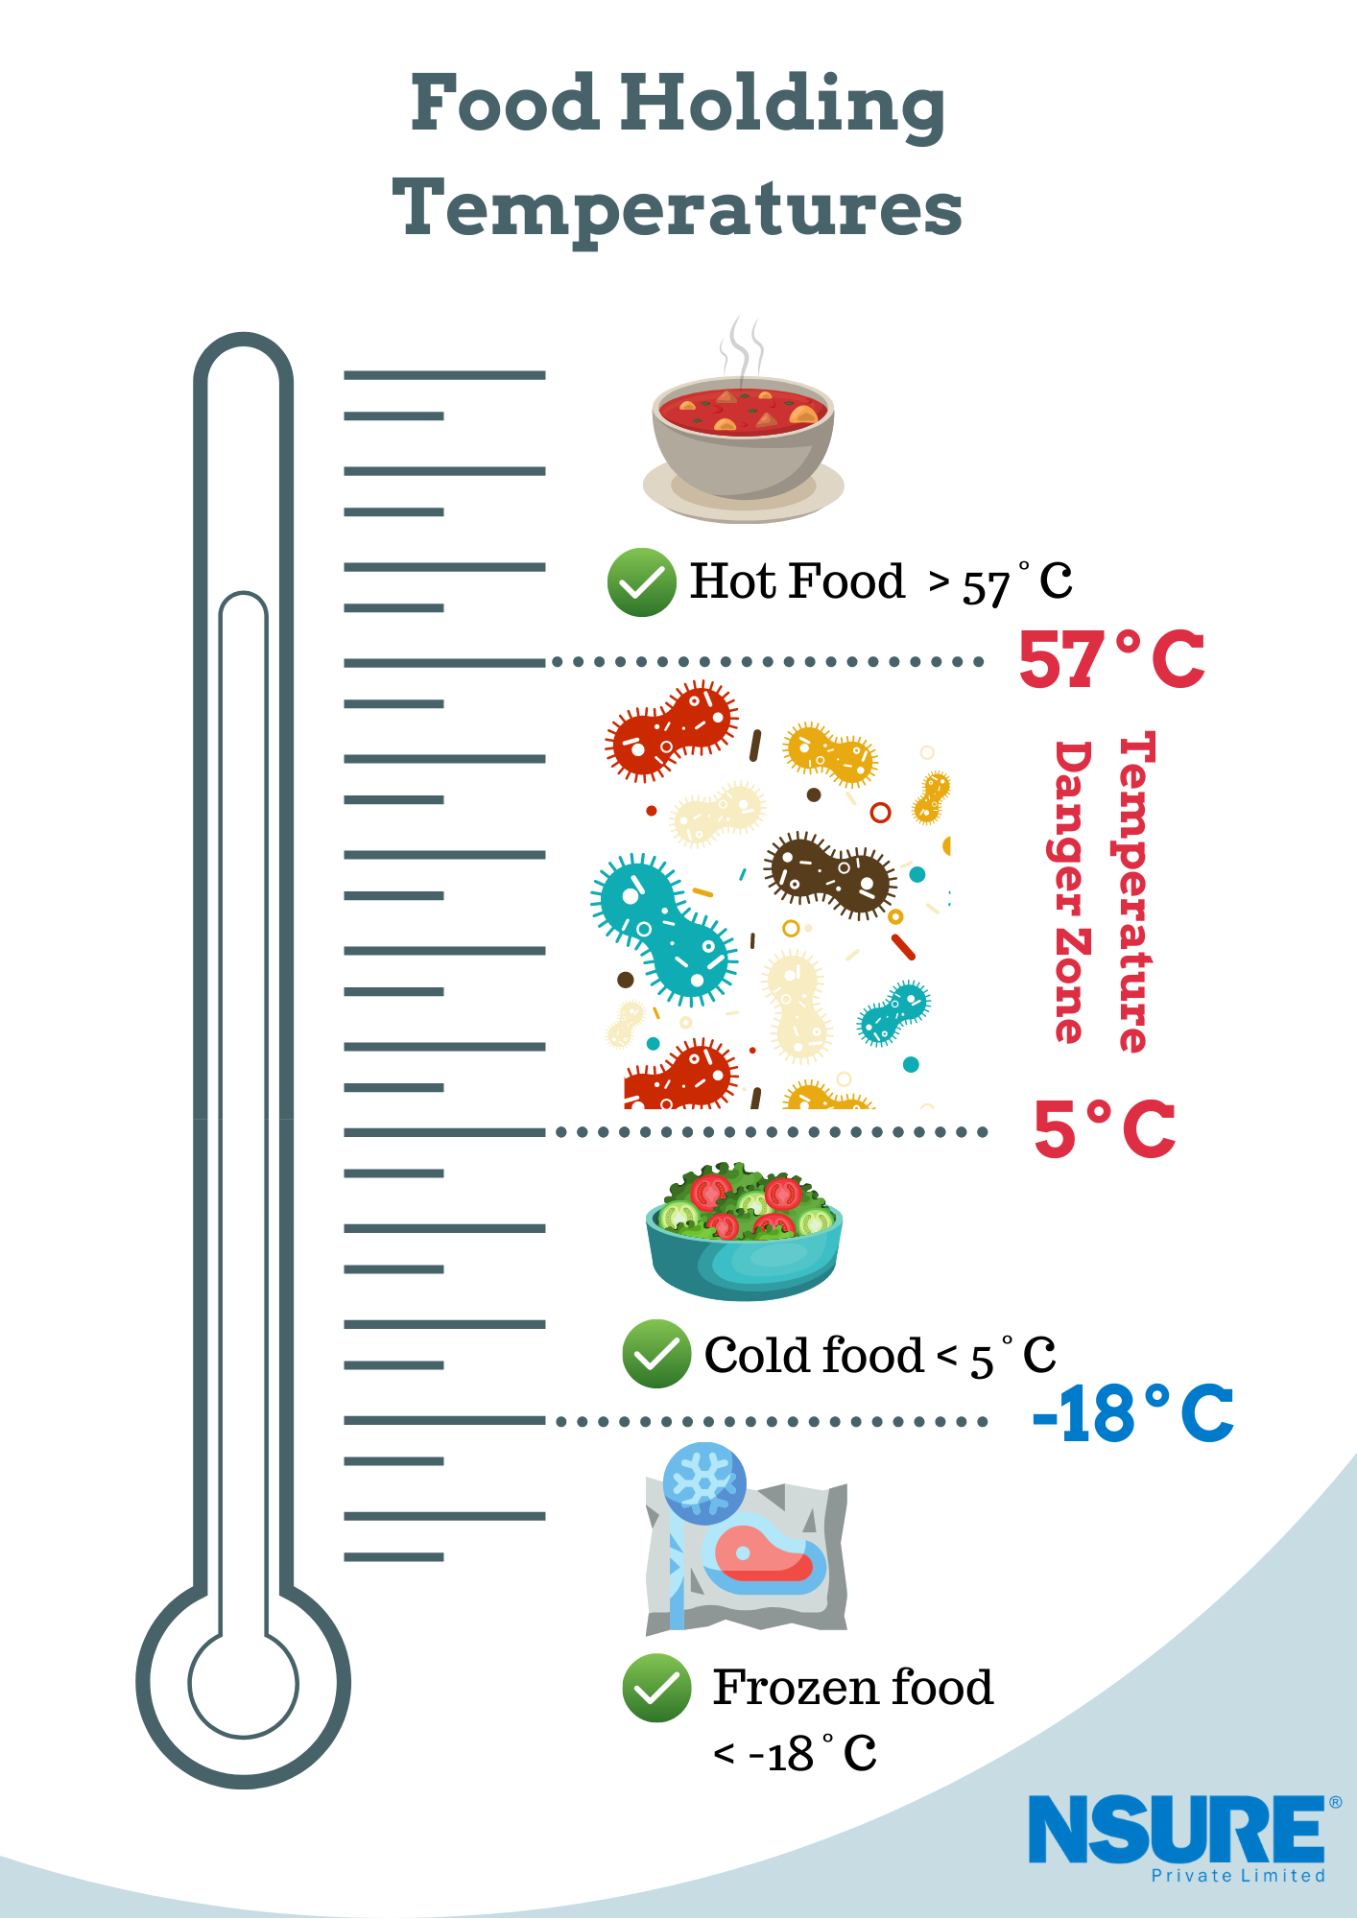
HAACP
Guidelines
135°
AECP Staff are required to follow all HACCP guidelines.
Three(3) clean, sanitized, and calibrated thermometers will be provided by the Food Services Manager to AECP Staff along with sanitation wipes.
ALL potentially hazardous items, hot and cold, must be temped and recorded onto the Daily Transport Record.
The Food Service Manager will add one carton of milk for temperature-taking purposes. Discard milk afterwards.
X
41°
0°

Slide 9
HAACP
Guidelines Continued…
38
When temping pre-packaged items such as packaged fruits and vegetables:
Sandwich the thermometer between two pre-packaged items to temp.
Do not puncture the bag of the pre-packaged item.
This can be done with all pre-packaged items such as carrots, apple slices, celery and so forth.
Cold items must temp 41° and below.

Slide 10
HAACP
Guidelines Continued…
38
When temping items like pre-packaged burritos and sandwiches :
Do NOT open pre-packaged items.
Puncture a hole into the packaging to temp food item inside.
Once temped the food item is still safe for consumption.

Slide 11
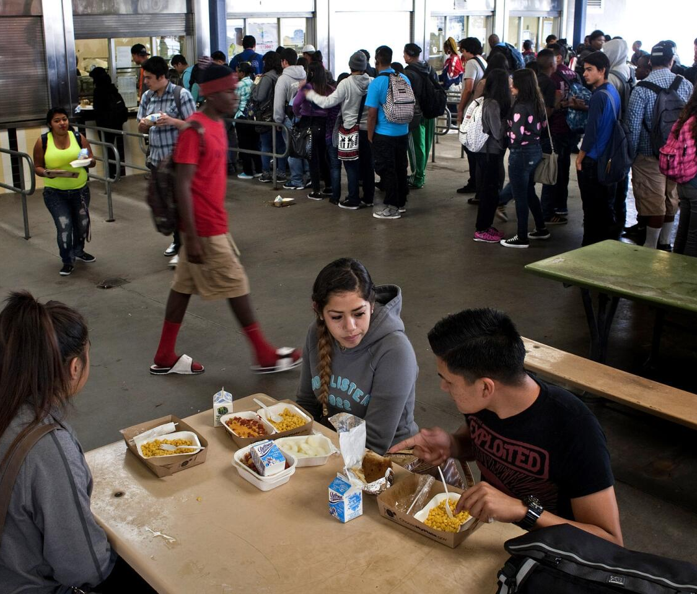
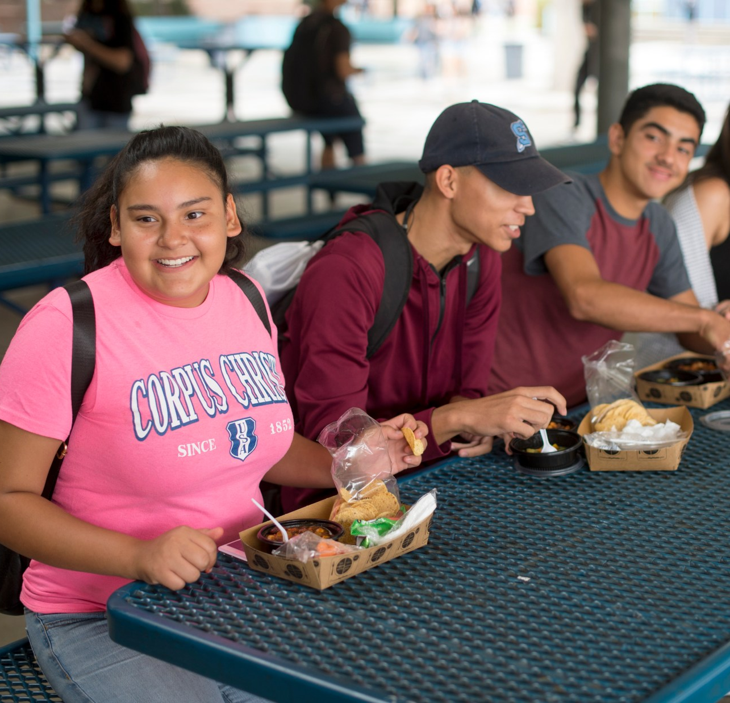
OFFER VS SERVE
To reduce food waste all After School Early Childhood Programs will follow Offer vs Serve guidelines:
At least 3 of the 5 meal components offered must be selected.
All hot entrees count as two components. Therefore, only one additional item is required to be taken.
Students are not required to take a fruit or vegetable.

Slide 12
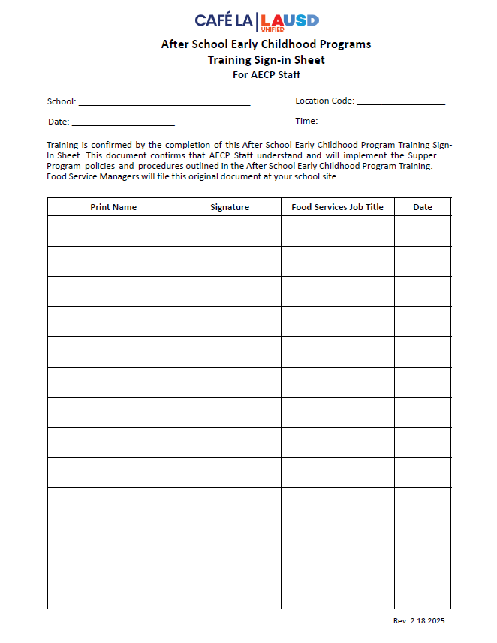
Training Sign-in Sheet
Managers and AECP staff must complete this training and sign off on the After School Early Childhood Programs Training Sign-in Sheet to be returned to the Food Services Manager.

Slide 13
Good Nutrition All Day Long
Providing healthy meals doesn’t stop once the last bell rings.

